Slide 1

Notes:
Reload codespace
Update settings.json.
Uncheck VS Code tabs except for Terminal
Hide Activity Bar
Hide Explorer
Remove comments from any pre-made code

Slide 2
data structures

Slide 3
abstract data types

Slide 4
queues
Notes:
- waiting in line

Slide 5
FIFO

Slide 6
enqueue
dequeue

Slide 7
const int CAPACITY = 50;
typedef struct
{
person people[CAPACITY];
int size;
} queue;

Slide 8
stacks
Notes:
- stack of sweaters
- Gmail inbox

Slide 9
LIFO

Slide 10
push
pop

Slide 11
typedef struct
{
person people[CAPACITY];
int size;
} stack;

Slide 12
const int CAPACITY = 50;
typedef struct
{
person people[CAPACITY];
int size;
} stack;

Slide 13
Notes:
https://www.youtube.com/watch?v=ItAG3s6KIEI
Prof. Shannon Duvall of Elon University

Slide 15
arrays

Slide 17
 | 1 | 2 | 3

Slide 18
 | 1 | 2 | 3

Slide 19
 | 1 | 2 | 3

Slide 20

 | 1 | 2 | 3 | h | e | l | l
o | , |  | w | o | r | l | d
\0

Slide 21
 | 1 | 2 | 3

Slide 22
 | 1 | 2 | 3
 | 1

Slide 23
 | 1 | 2 | 3
 | 1 | 2

Slide 24
 | 1 | 2 | 3
 | 1 | 2 | 3

Slide 25
 | 1 | 2 | 3
 | 1 | 2 | 3 | 4

Slide 26
 | 1 | 2 | 3 | 4
Notes:
list{0,1,2}.c

Slide 27
data structures

Slide 28
struct
.
*

Slide 29
struct
->

Slide 30
linked lists

Slide 32
 |  | 1 0x123

Slide 33
 |  | 1 0x123
 |  |  |  | 2 0x456

Slide 34
 |  | 1 0x123
 |  |  |  | 2 0x456
 |  |  |  |  |  | 3 0x789

Slide 35
 |  | 1 0x123
 |  |  |  | 2 0x456
 |  |  |  |  |  | 3 0x789

Slide 36
 |  | 1 0x123
 |  | 0x456 |  | 2 0x456
 |  |  |  |  |  | 3 0x789

Slide 37
 |  | 1 0x123
 |  | 0x456 |  | 2 0x456
 |  |  |  | 0x789 |  | 3 0x789

Slide 38
 |  | 1 0x123
 |  | 0x456 |  | 2 0x456
 |  |  |  | 0x789 |  | 3 0x789
 |  |  |  |  |  | 0x0

Slide 39
 |  | 1 0x123
 |  | 0x456 |  | 2 0x456
 |  |  |  | 0x789 |  | 3 0x789
 |  |  |  |  |  | NULL

Slide 40
 |  | 1 0x123
 |  | 0x456 |  | 2 0x456
0x123 |  |  |  | 0x789 |  | 3 0x789
 |  |  |  |  |  | NULL

Slide 41
 |  | 1
 |  |  |  | 2
 |  |  |  |  |  | 3

Slide 42
typedef struct
{
string name;
string number;
} person;

Slide 43
typedef struct
{
char *name;
char *number;
} person;

Slide 44
typedef struct
{
} person;

Slide 45
typedef struct
{
} node;

Slide 46
typedef struct
{
int number;
} node;

Slide 47
typedef struct
{
int number;
node *next;
} node;

Slide 48
typedef struct node
{
int number;
node *next;
} node;

Slide 49
typedef struct node
{
int number;
struct node *next;
} node;

Slide 51
node *list;

Slide 52
node *list;
list

Slide 53
node *list = NULL;
list

Slide 54
node *list = NULL;
list

Slide 55
node *n = malloc(sizeof(node));
list

Slide 56
node *n = malloc(sizeof(node));
list
n

Slide 57
node *n = malloc(sizeof(node));
list
number
n
next

Slide 58
node *n = malloc(sizeof(node));
list
number
n
next

Slide 59
(*n).number = 1;
list
number
n
next

Slide 60
(*n).number = 1;
list
1
number
n
next

Slide 61
n->number = 1;
list
1
number
n
next

Slide 62
n->next = NULL;
list
1
number
n
next

Slide 63
n->next = NULL;
list
1
number
n
next

Slide 64
list = n;
list
1
number
n
next

Slide 65
list = n;
list
1
number
n
next

Slide 66
list
1

Slide 67
node *n = malloc(sizeof(node));
list
1

Slide 68
node *n = malloc(sizeof(node));
list
1
n

Slide 69
node *n = malloc(sizeof(node));
list
1
n

Slide 70
node *n = malloc(sizeof(node));
list
1
n

Slide 71
n->number = 2;
list
1
n

Slide 72
n->number = 2;
list
2
1
n

Slide 73
n->next = NULL;
list
2
1
n

Slide 74
n->next = NULL;
list
2
1
n

Slide 75
list
2
1
n

Slide 76
list = n;
list
2
1
n

Slide 77
list = n;
list
2
1
n

Slide 78
list = n;
list
2
1
n

Slide 79
list
2
1
n

Slide 80
n->next = list;
list
2
1
n

Slide 81
n->next = list;
list
2
1
n

Slide 82
list = n;
list
2
1
n

Slide 83
list = n;
list
2
1
n

Slide 84
list
2
1

Slide 85
list
2
1
3
Notes:
start list3.c

Slide 86
ptr
list
2
1
3

Slide 87
ptr
list
2
1
3

Slide 88
ptr
list
2
1
3

Slide 89
ptr
list
2
1
3
Notes:
finish list3.c
list4.c

Slide 90
list
2
1
3

Slide 91
O(n²)
O(n log n)
O(n)
O(log n)
O(1)

Slide 93
list

Slide 94
list
1

Slide 95
list
2
1

Slide 96
list
2
1
3

Slide 98
list

Slide 99
list
1

Slide 100
2
list
1

Slide 101
2
list
1
3
Notes:
mention list5.c

Slide 102
O(n²)
O(n log n)
O(n)
O(log n)
O(1)

Slide 104
list

Slide 105
list
2

Slide 106
list
2
1

Slide 107
4
list
2
1

Slide 108
4
list
2
3
1
Notes:
mention list6.c

Slide 109
O(n²)
O(n log n)
O(n)
O(log n)
O(1)

Slide 110


Slide 111
trees

Slide 112
binary search trees

Slide 113
 | 1 | 2 | 3 | 4 | 5 | 6 | 7

Slide 114
 | 1 | 2 | 3 | 4 | 5 | 6 | 7

Slide 115
 | 1 | 2 | 3 | 4 | 5 | 6 | 7

Slide 116
 | 1 | 2 | 3 | 4 | 5 | 6 | 7

Slide 117
4
2
6
1
3
5
7

Slide 118
4
2
6
1
3
5
7
Notes:
each square is an abstraction of a node now, no need to keep drawing rects

Slide 119
typedef struct node
{
int number;
struct node *next;
} node;

Slide 120
typedef struct node
{
int number;
} node;

Slide 121
typedef struct node
{
int number;
} node;

Slide 122
typedef struct node
{
int number;
struct node *left;
struct node *right;
} node;

Slide 123
4
2
6
1
3
5
7

Slide 124
bool search(node *tree, int number)
{
if (tree == NULL)
{
return false;
}
else if (number < tree->number)
{
return search(tree->left, number);
}
else if (number > tree->number)
{
return search(tree->right, number);
}
else if (number == tree->number)
{
return true;
}
}

Slide 125
bool search(node *tree, int number)
{
if (tree == NULL)
{
return false;
}
else if (number < tree->number)
{
return search(tree->left, number);
}
else if (number > tree->number)
{
return search(tree->right, number);
}
else if (number == tree->number)
{
return true;
}
}

Slide 126
bool search(node *tree, int number)
{
if (tree == NULL)
{
return false;
}
else if (number < tree->number)
{
return search(tree->left, number);
}
else if (number > tree->number)
{
return search(tree->right, number);
}
else if (number == tree->number)
{
return true;
}
}

Slide 127
bool search(node *tree, int number)
{
if (tree == NULL)
{
return false;
}
else if (number < tree->number)
{
return search(tree->left, number);
}
else if (number > tree->number)
{
return search(tree->right, number);
}
else if (number == tree->number)
{
return true;
}
}

Slide 128
bool search(node *tree, int number)
{
if (tree == NULL)
{
return false;
}
else if (number < tree->number)
{
return search(tree->left, number);
}
else if (number > tree->number)
{
return search(tree->right, number);
}
else if (number == tree->number)
{
return true;
}
}

Slide 129
bool search(node *tree, int number)
{
if (tree == NULL)
{
return false;
}
else if (number < tree->number)
{
return search(tree->left, number);
}
else if (number > tree->number)
{
return search(tree->right, number);
}
else if (number == tree->number)
{
return true;
}
}

Slide 130
4
2
6
1
3
5
7

Slide 131
Notes:
What if we build a BST from scratch, starting with 2?

Slide 132
2

Slide 133
2
1
Notes:
then 1

Slide 134
2
1
3
Notes:
then 3. looks fine.

Slide 135
Notes:
what if the insertion order is 1-2-3 instead?

Slide 136
1

Slide 137
1
2

Slide 138
1
2
3

Slide 139
O(n²)
O(n log n)
O(n)
O(log n)
O(1)

Slide 140
dictionaries

Slide 142
word | definition

Slide 143
key | value

Slide 144

Notes:
https://apps.apple.com/us/app/contacts/id1069512615#?platform=iphone

Slide 145
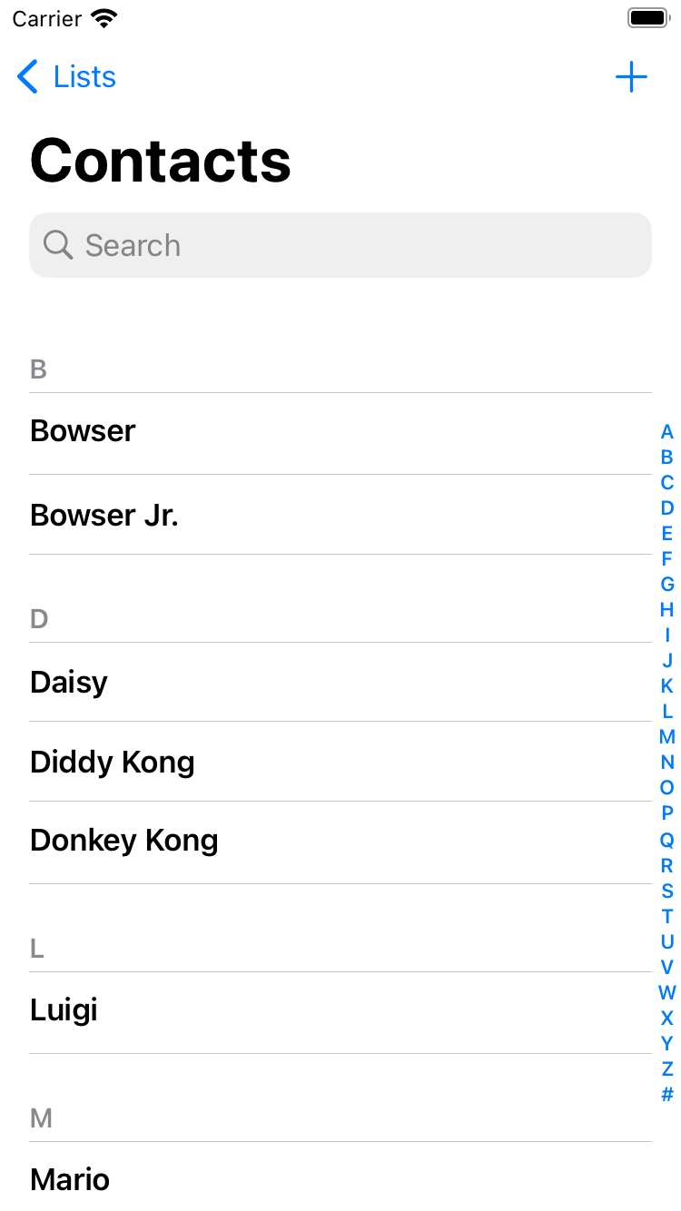
Notes:
https://nintendo.fandom.com/wiki/Nintendo_characters#Mario_series_(including_sub-franchises)

Slide 146


Slide 147
name | number

Slide 148
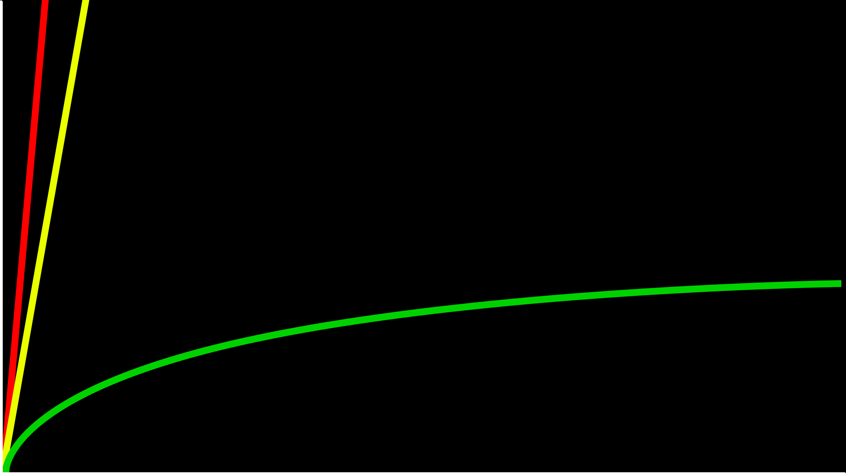
O(n)
time to solve
O(log n)
size of problem

Slide 149
O(n)
time to solve
O(log n)
O(1)
size of problem

Slide 150
hashing
Notes:
cards into buckets

Slide 151
hash function

Slide 152
hash tables

Slide 154
0
1
2
3
4
5
6
7
8
9
10
11
12
13
14
15
16
17
18
19
20
21
22
23
24
25

Slide 155
A
B
C
D
E
F
G
H
I
J
K
L
M
N
O
P
Q
R
S
T
U
V
W
X
Y
Z

Slide 157
Mario

Slide 158
Luigi
Mario

Slide 159
Luigi
Mario
Peach

Slide 160
Birdo
Daisy
Goomba
Isabelle
King Boo
Luigi
Mario
Peach
Rosalina
Shy Guy
Toad
Wario
Yoshi
Zelda

Slide 161
Birdo
Daisy
Goomba
Isabelle
King Boo
Luigi
Lakitu
Mario
Peach
Rosalina
Shy Guy
Toad
Wario
Yoshi
Zelda

Slide 162
Birdo
Daisy
Goomba
Isabelle
King Boo
Luigi
Lakitu
Link
Mario
Peach
Rosalina
Shy Guy
Toad
Wario
Yoshi
Zelda

Slide 163
Birdo
Bowser
Bowser Jr.
Daisy
Donkey Kong
Diddy Kong
Dry Bones
Goomba
Ganon
Isabelle
King Boo
K.K. Slider
Luigi
Lakitu
Link
Mario
Peach
Petey Piranha
Rosalina
Shy Guy
Spike
Toad
Toadette
Tom Nook
Wario
Waluigi
Yoshi
Zelda

Slide 164
O(n²)
O(n log n)
O(n)
O(log n)
O(1)

Slide 165
typedef struct
{
char *name;
char *number;
} person;

Slide 166
typedef struct node
{
char *name; char *number;
struct node *next;
} node;

Slide 167
node *table[26];

Slide 168
input →
→ output

Slide 169
hash function

Slide 170
Mario →
→ 12

Slide 171
Luigi →
→ 11

Slide 172
Laa
Lab
Lac
Lad
Lae
Laf
Lag
Lah
Lai
Laj
Lak
...
Lim
Lin
Lio
...
Luh
Lui
Luj
Lakitu
Link
Luigi
Notes:
17,576 buckets

Slide 173
#include <ctype.h>
int hash(char *word)
{
return toupper(word[0]) - 'A';
}

Slide 174
#include <ctype.h>
int hash(const char *word)
{
return toupper(word[0]) - 'A';
}

Slide 175
#include <ctype.h>
unsigned int hash(const char *word)
{
return toupper(word[0]) - 'A';
}

Slide 176
O(n)

Slide 177
O(n/k)

Slide 178
O(n)

Slide 179
O(1)

Slide 180
tries

Slide 181
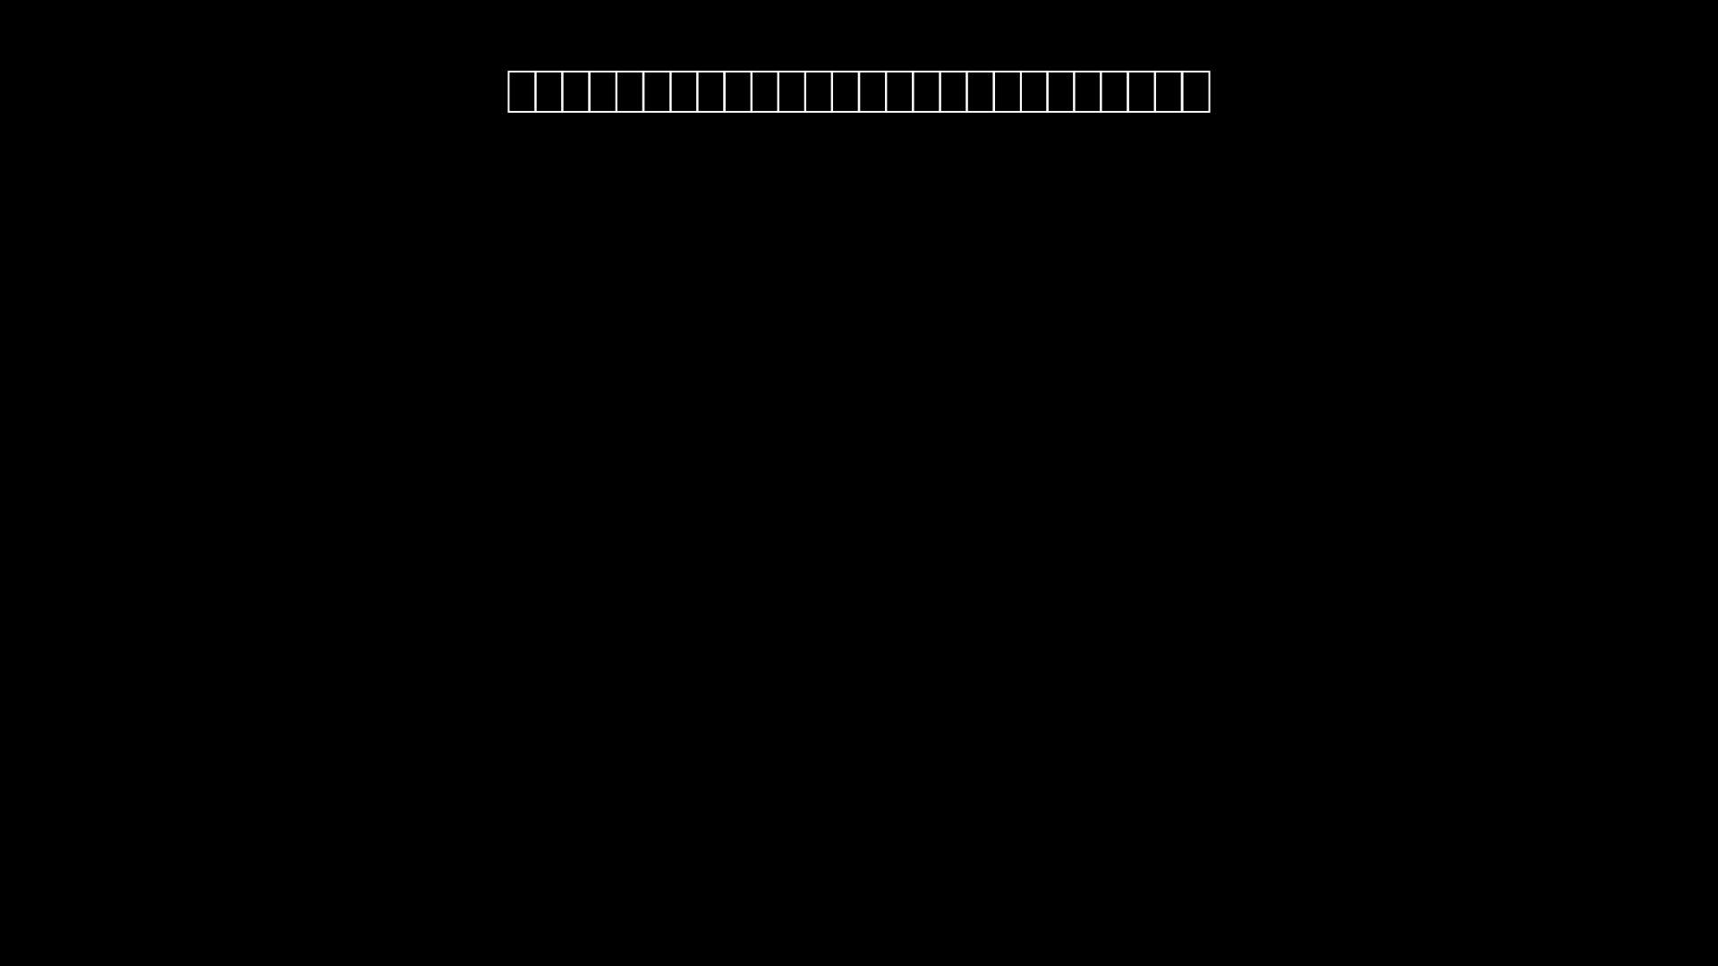

Slide 182
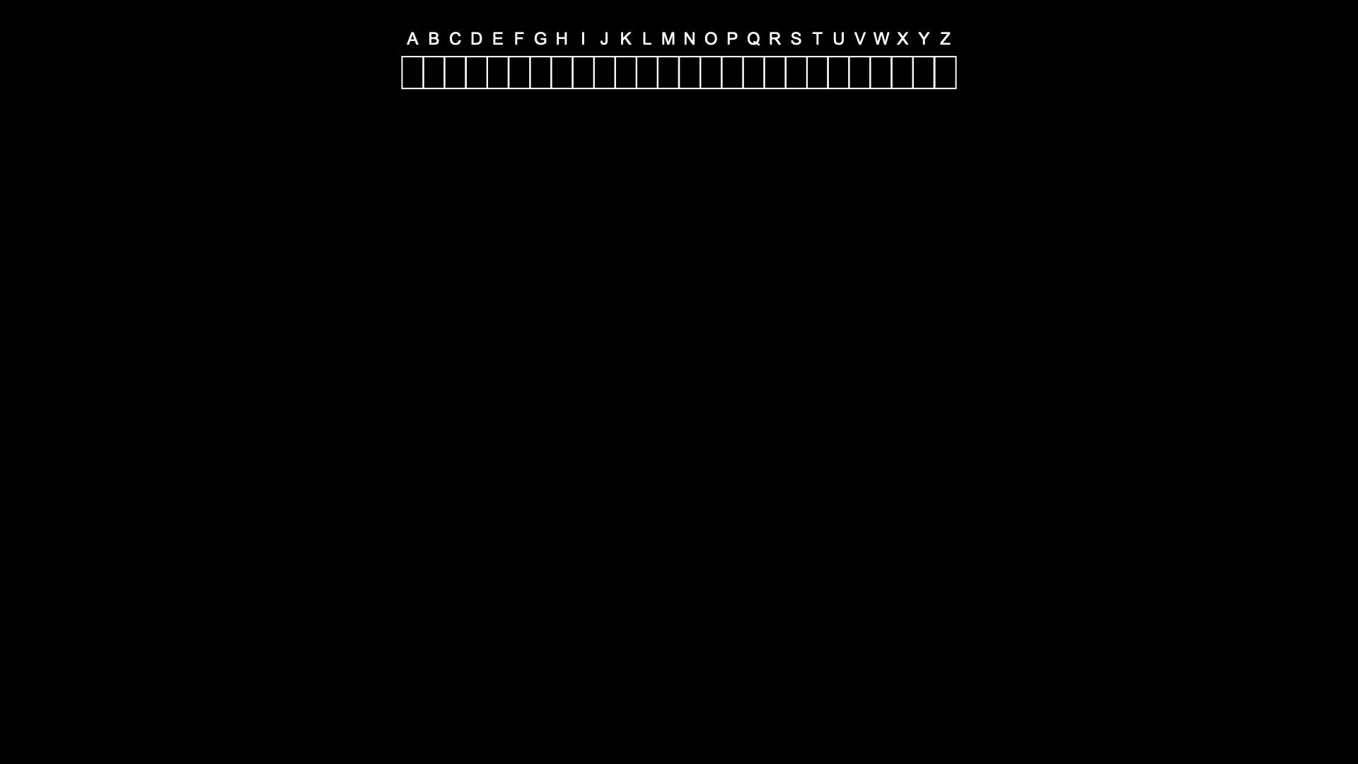

Slide 183
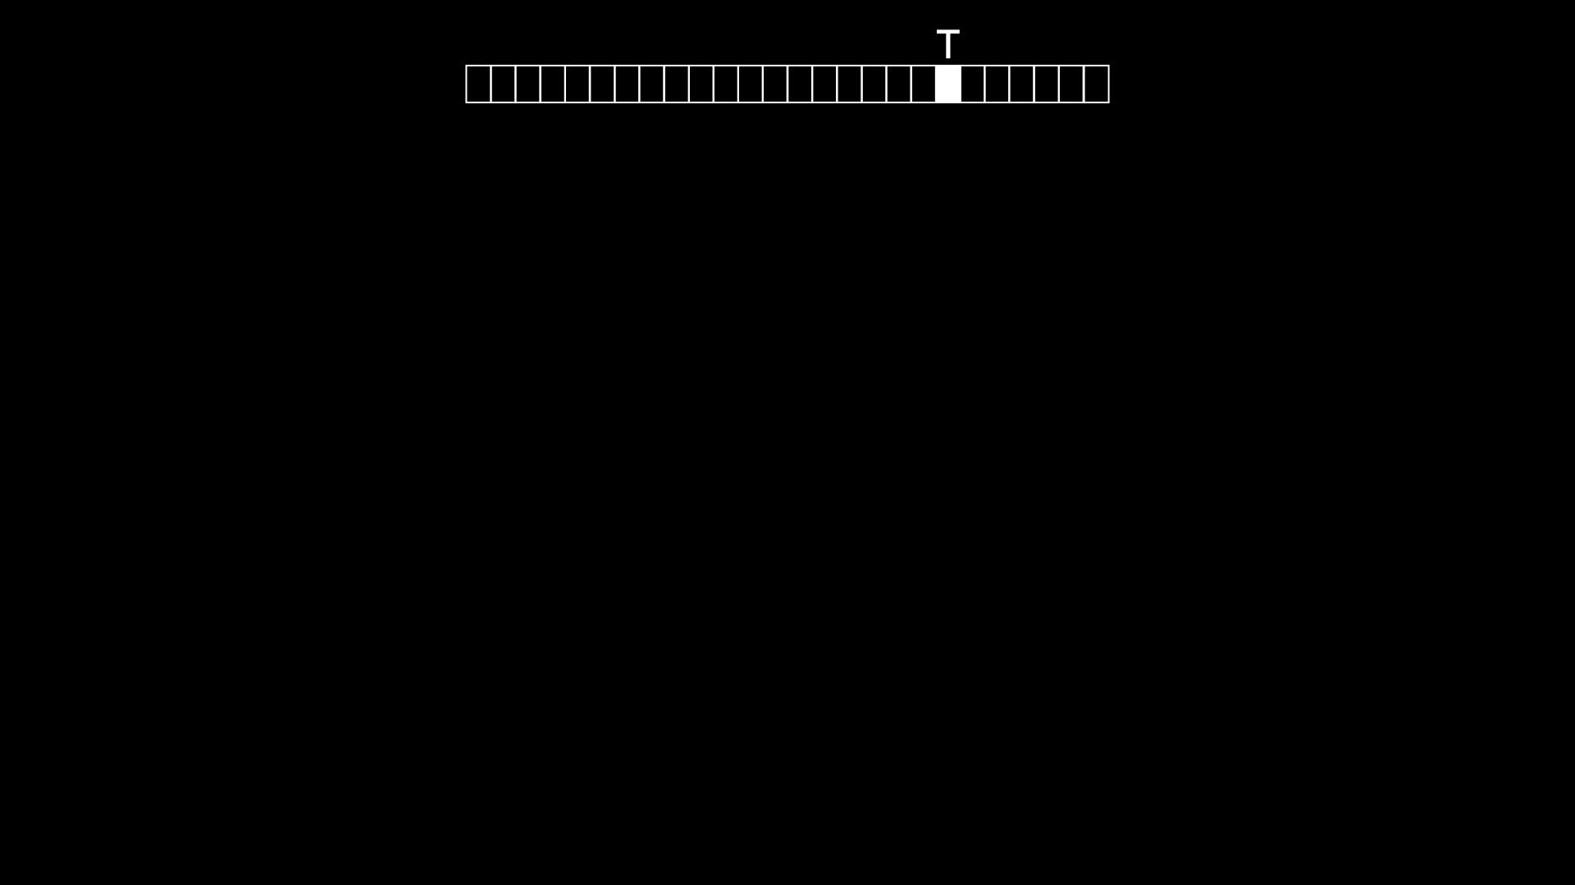

Slide 184
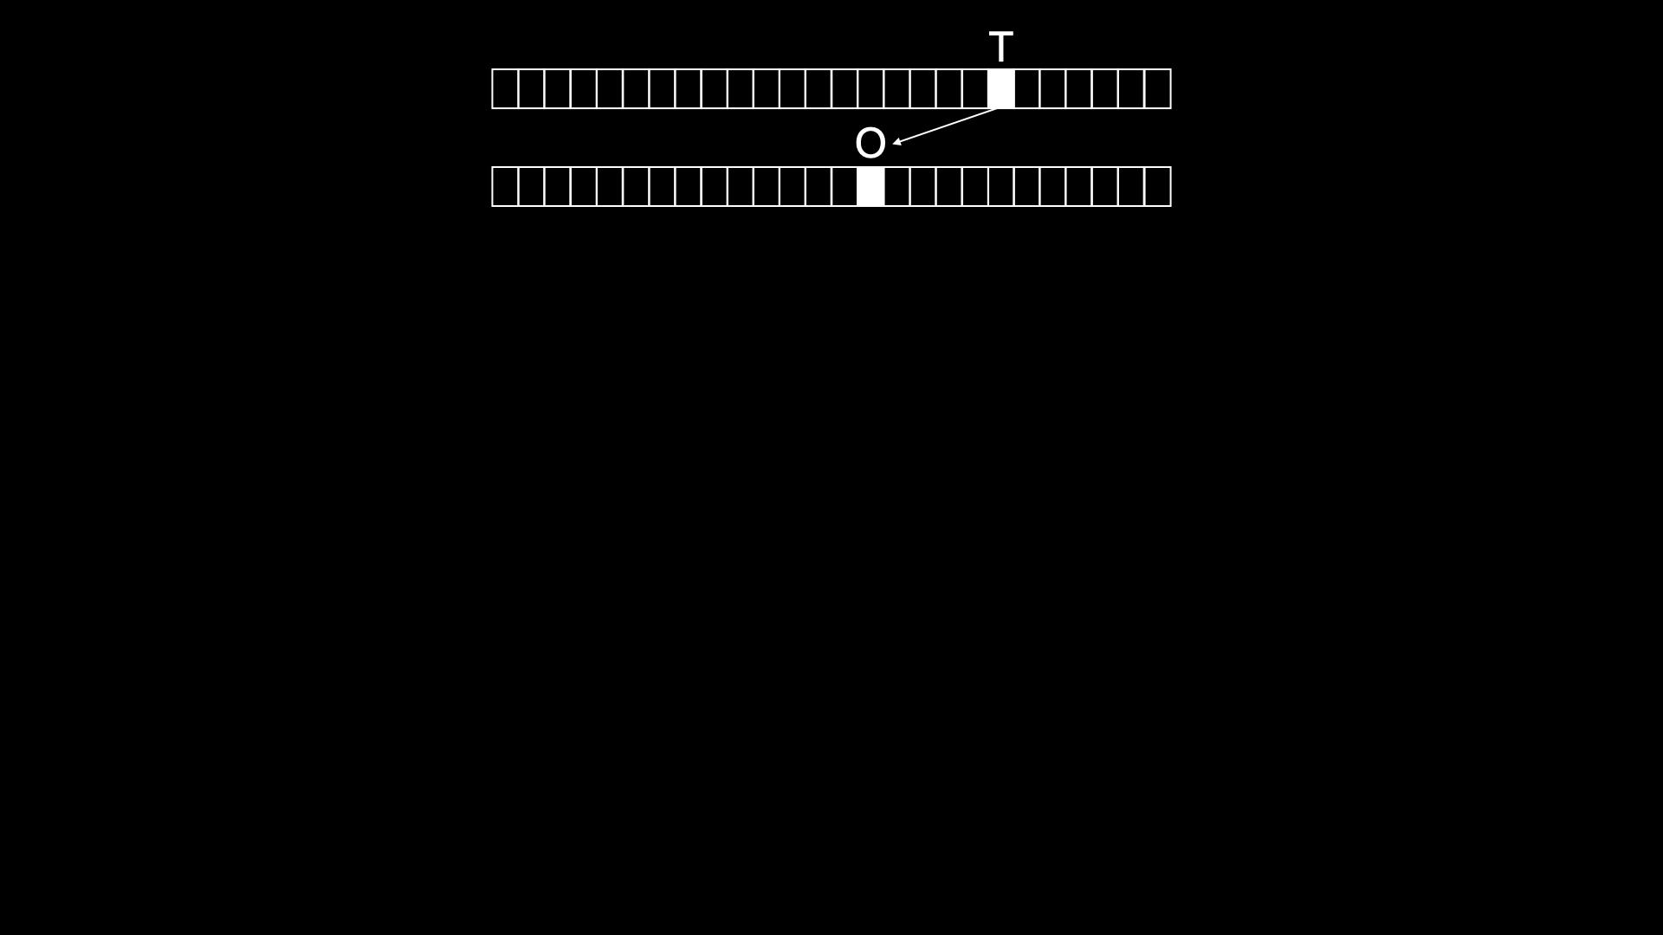

Slide 185
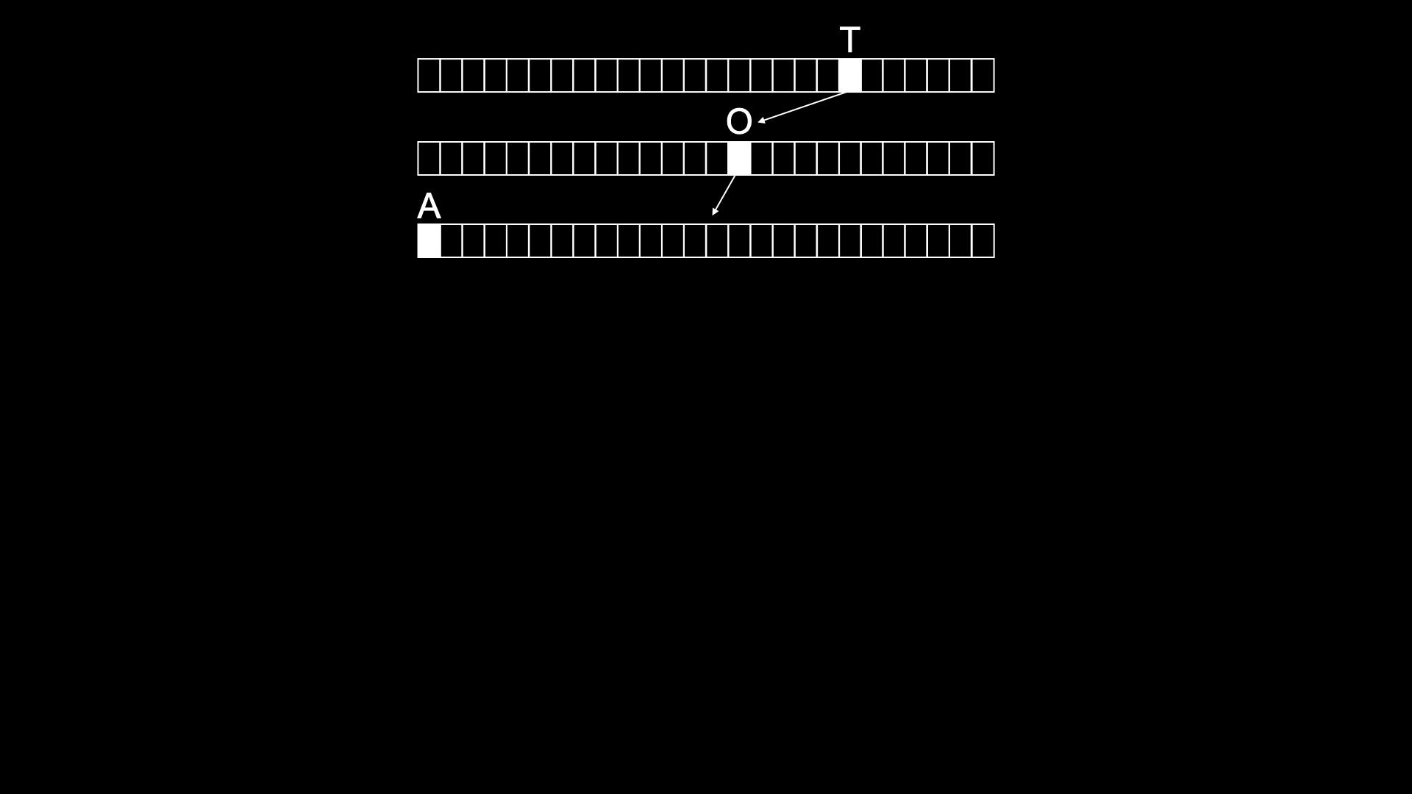

Slide 186
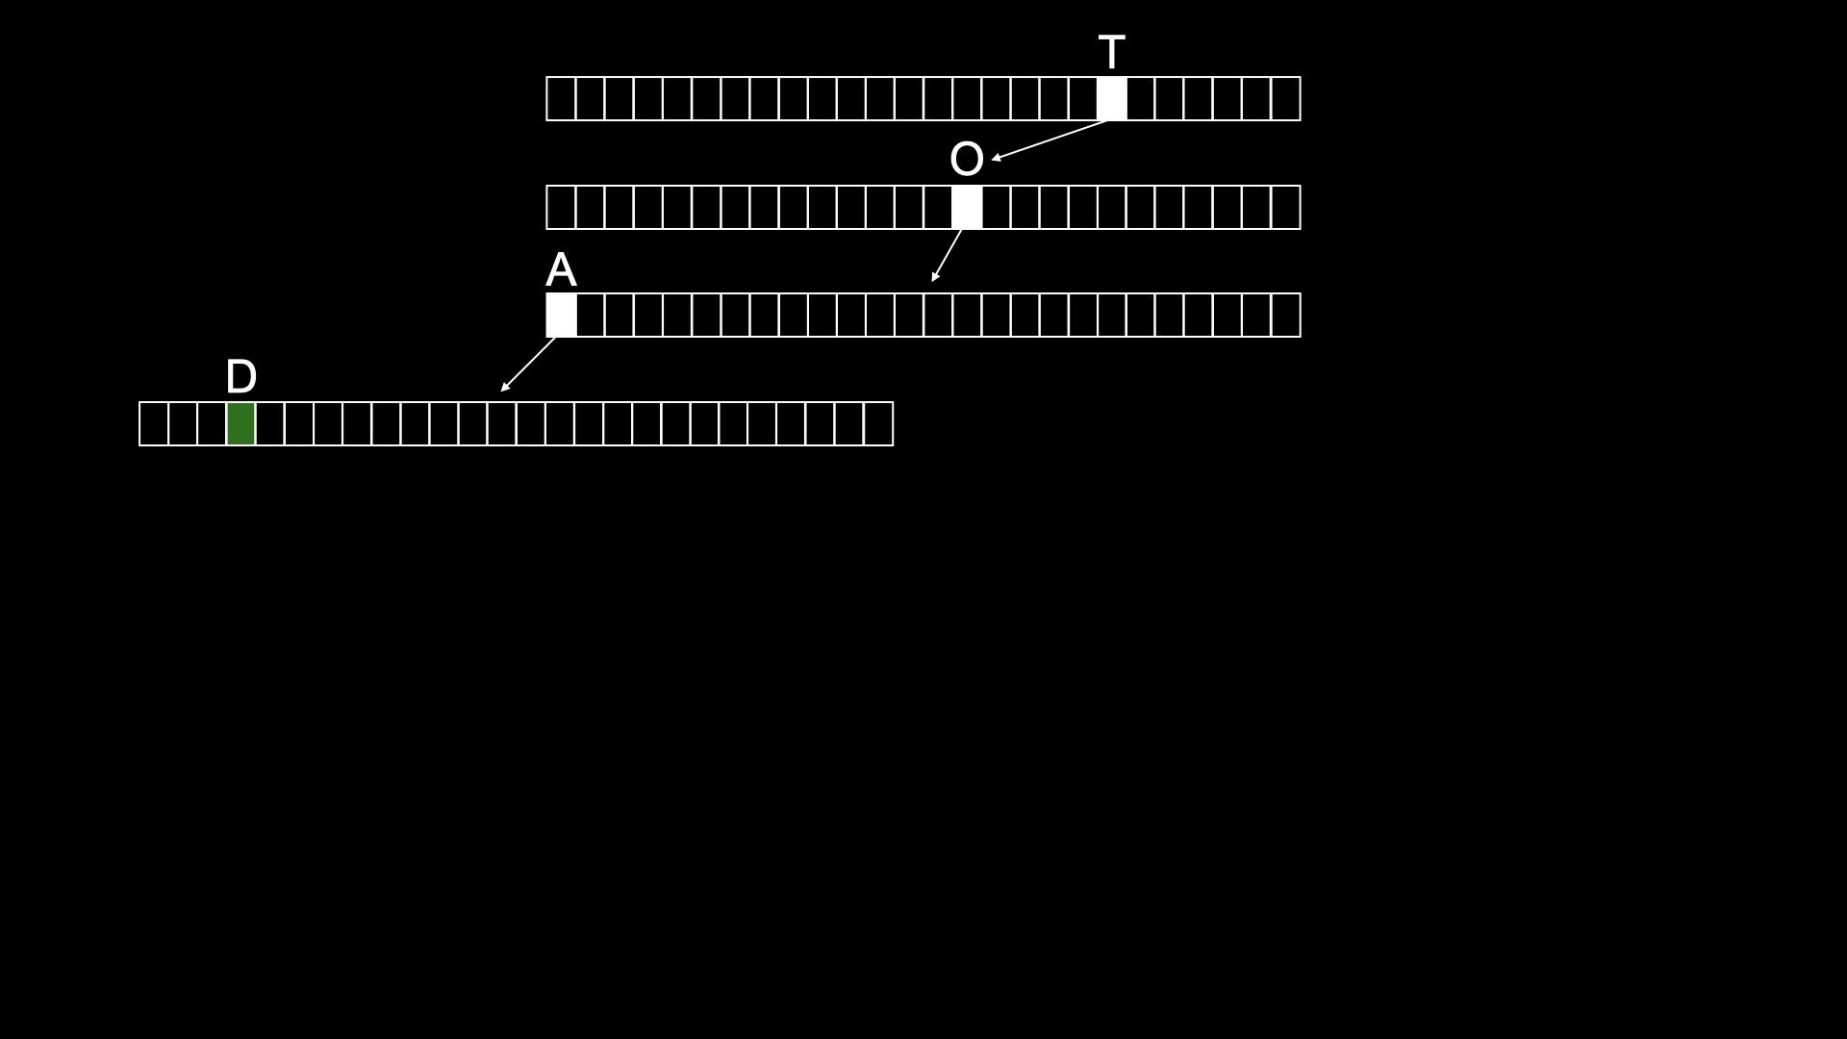

Slide 187
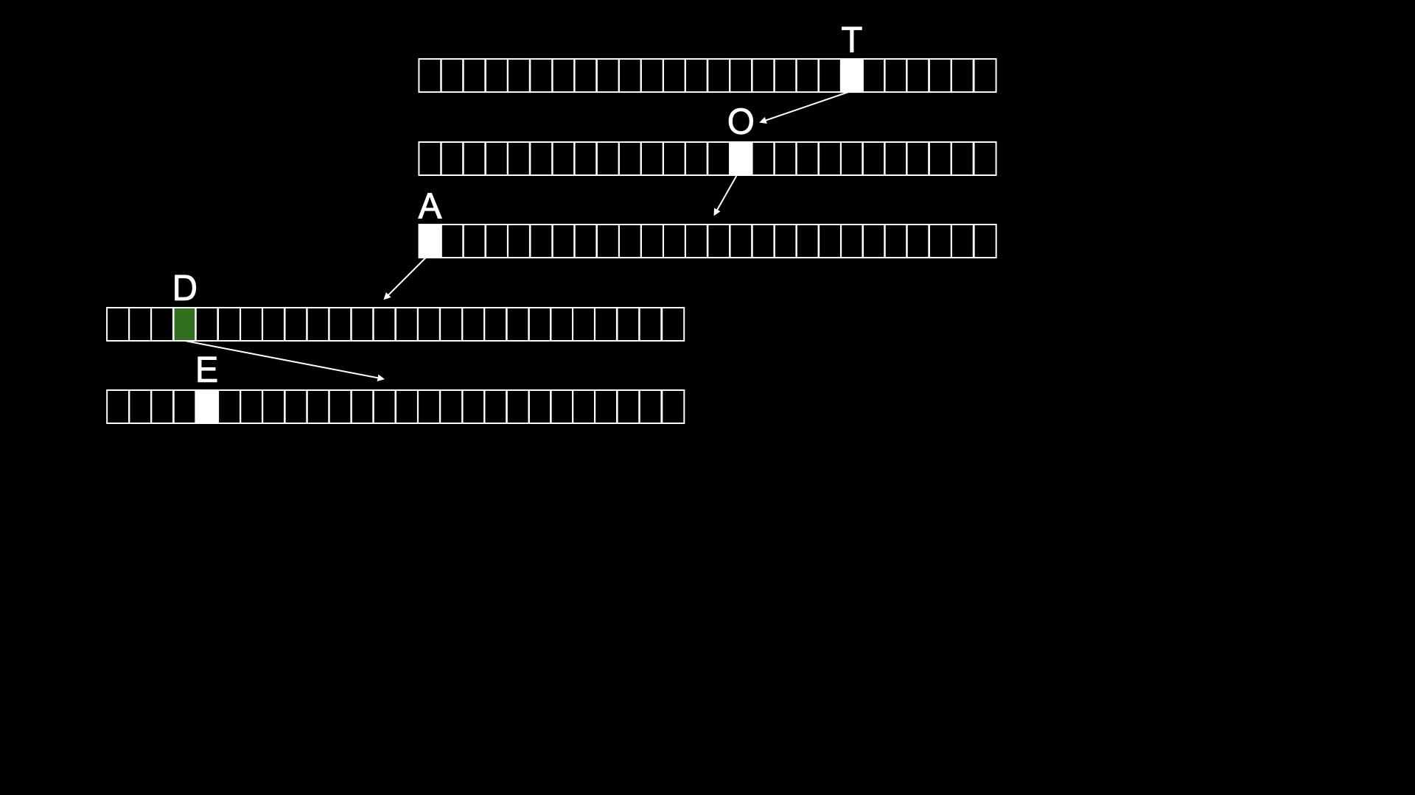

Slide 188
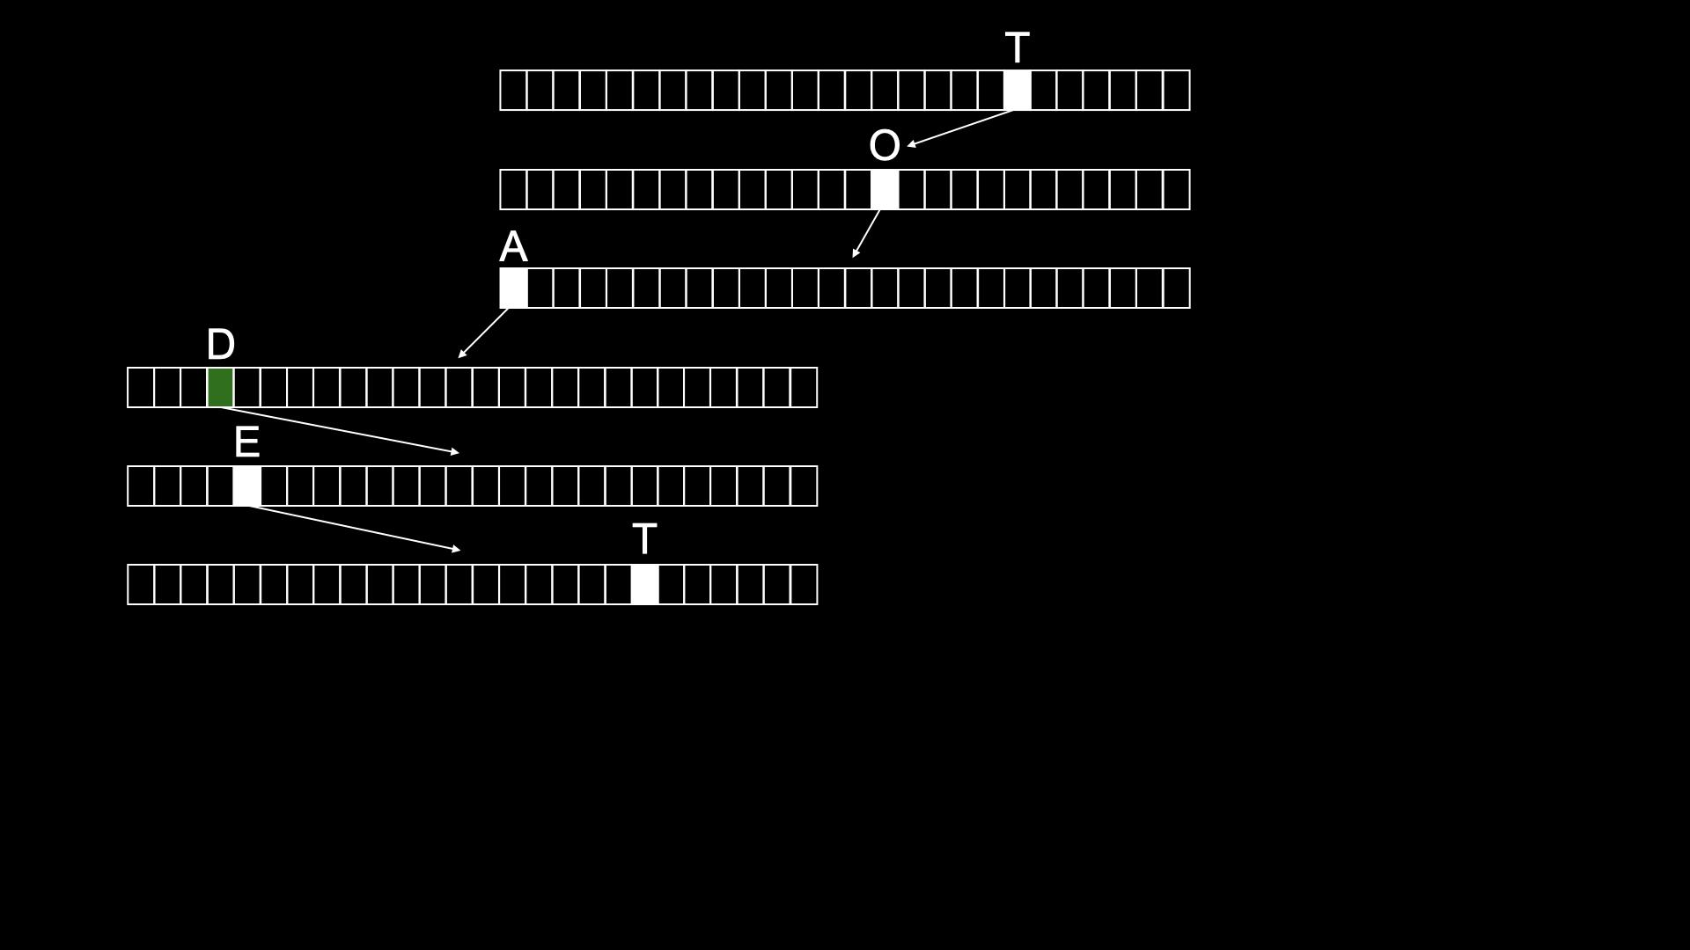

Slide 189
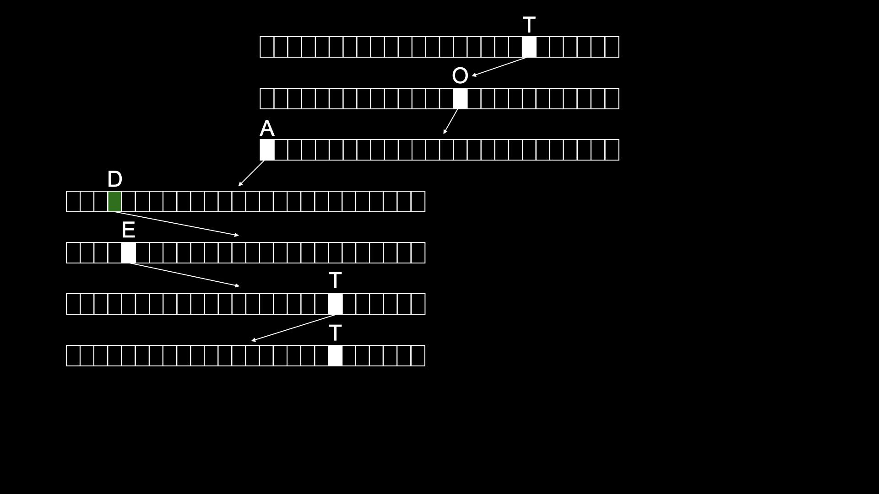

Slide 190
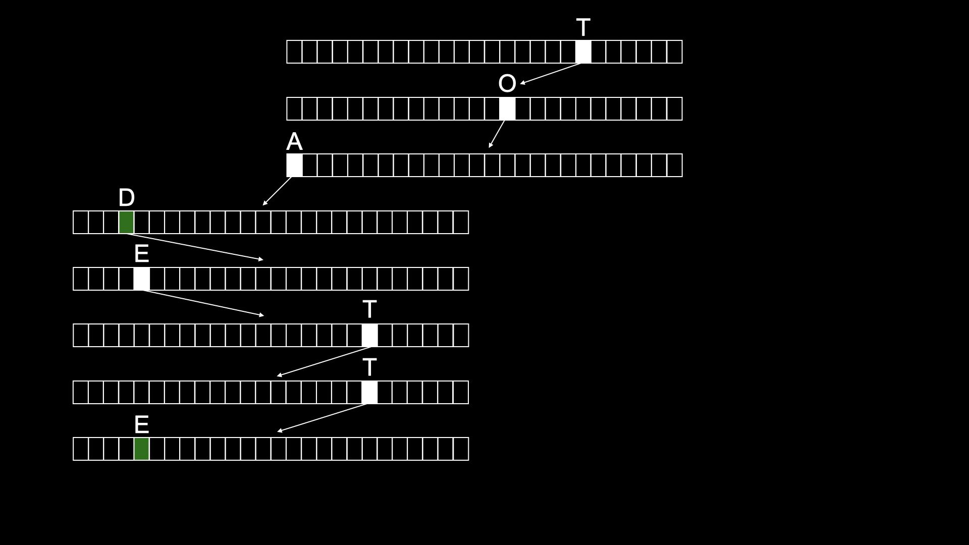

Slide 191
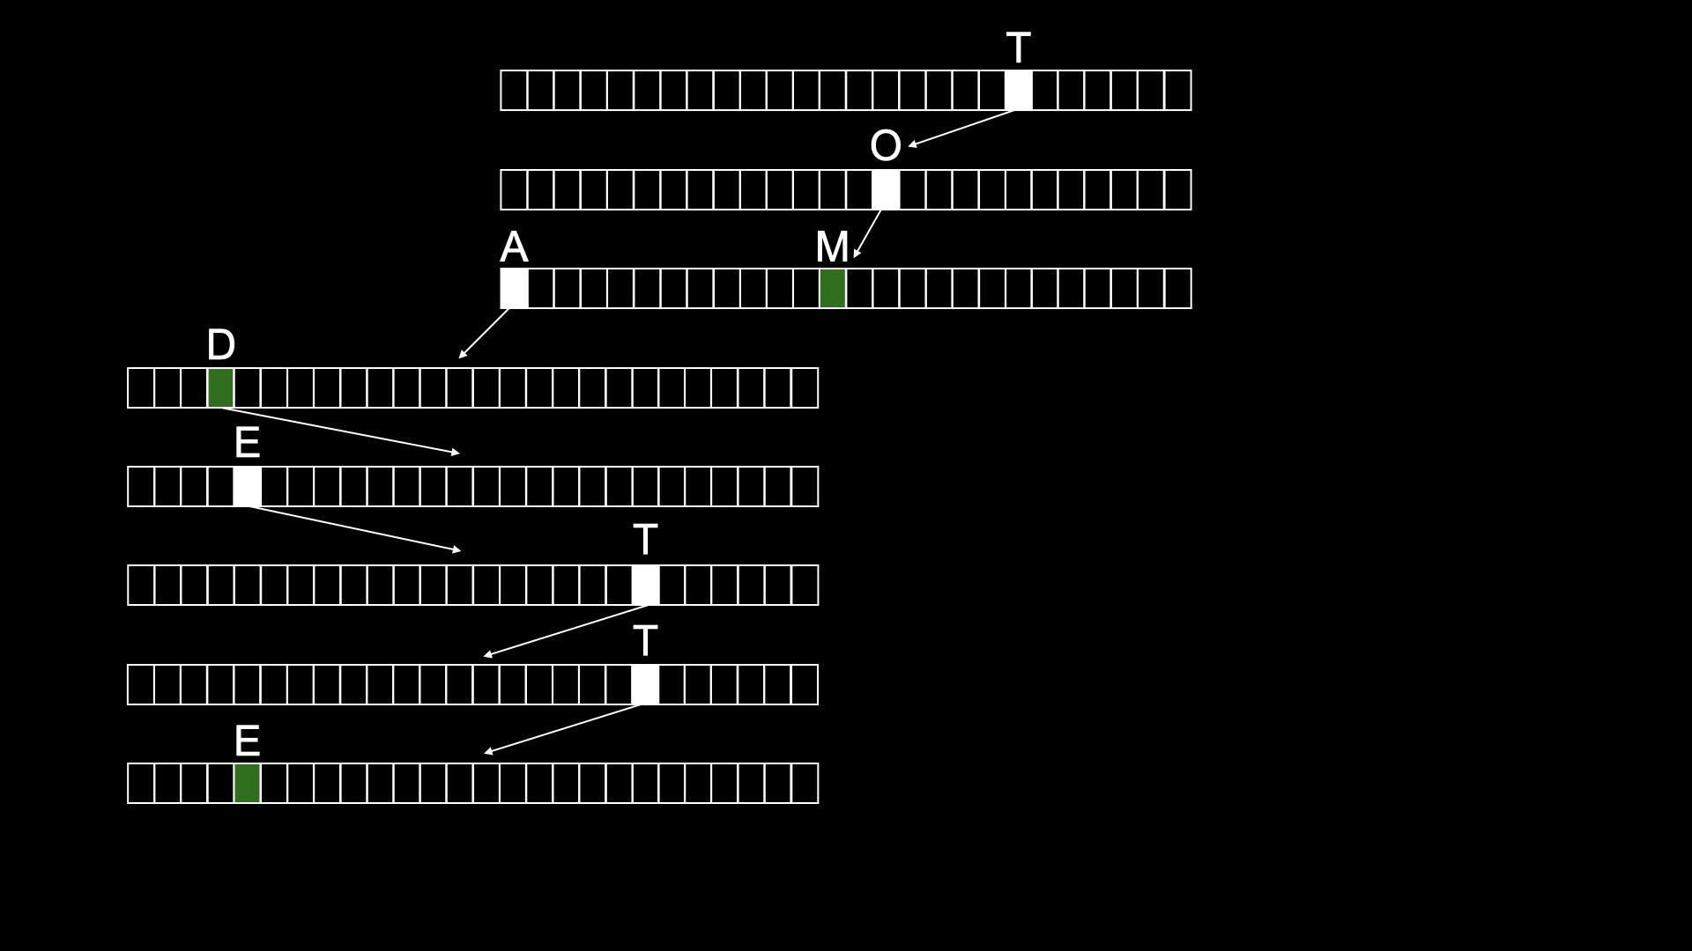

Slide 192
typedef struct node
{
struct node *children[26];
char *number;
} node;
Notes:
don't need to bother storing name, since implicit in trie

Slide 193
node *trie;

Slide 194
O(n²)
O(n log n)
O(n)
O(log n)
O(1)

